Slide 1
Machine Learning Bootcamp
Organizer Guide

Slide 2
What is Machine Learning (ML) Bootcamp?
Intended Audience
ML Bootcamp is one stop location to learn about Google’s latest ML offerings. The bootcamp provides fast paced, practical introduction to Machine Learning - divided in three modules : Design, Learn, Study & Build.
Developers working in startups/enterprises who’re interested to learn and apply Machine Learning in their products/projects.

Slide 3
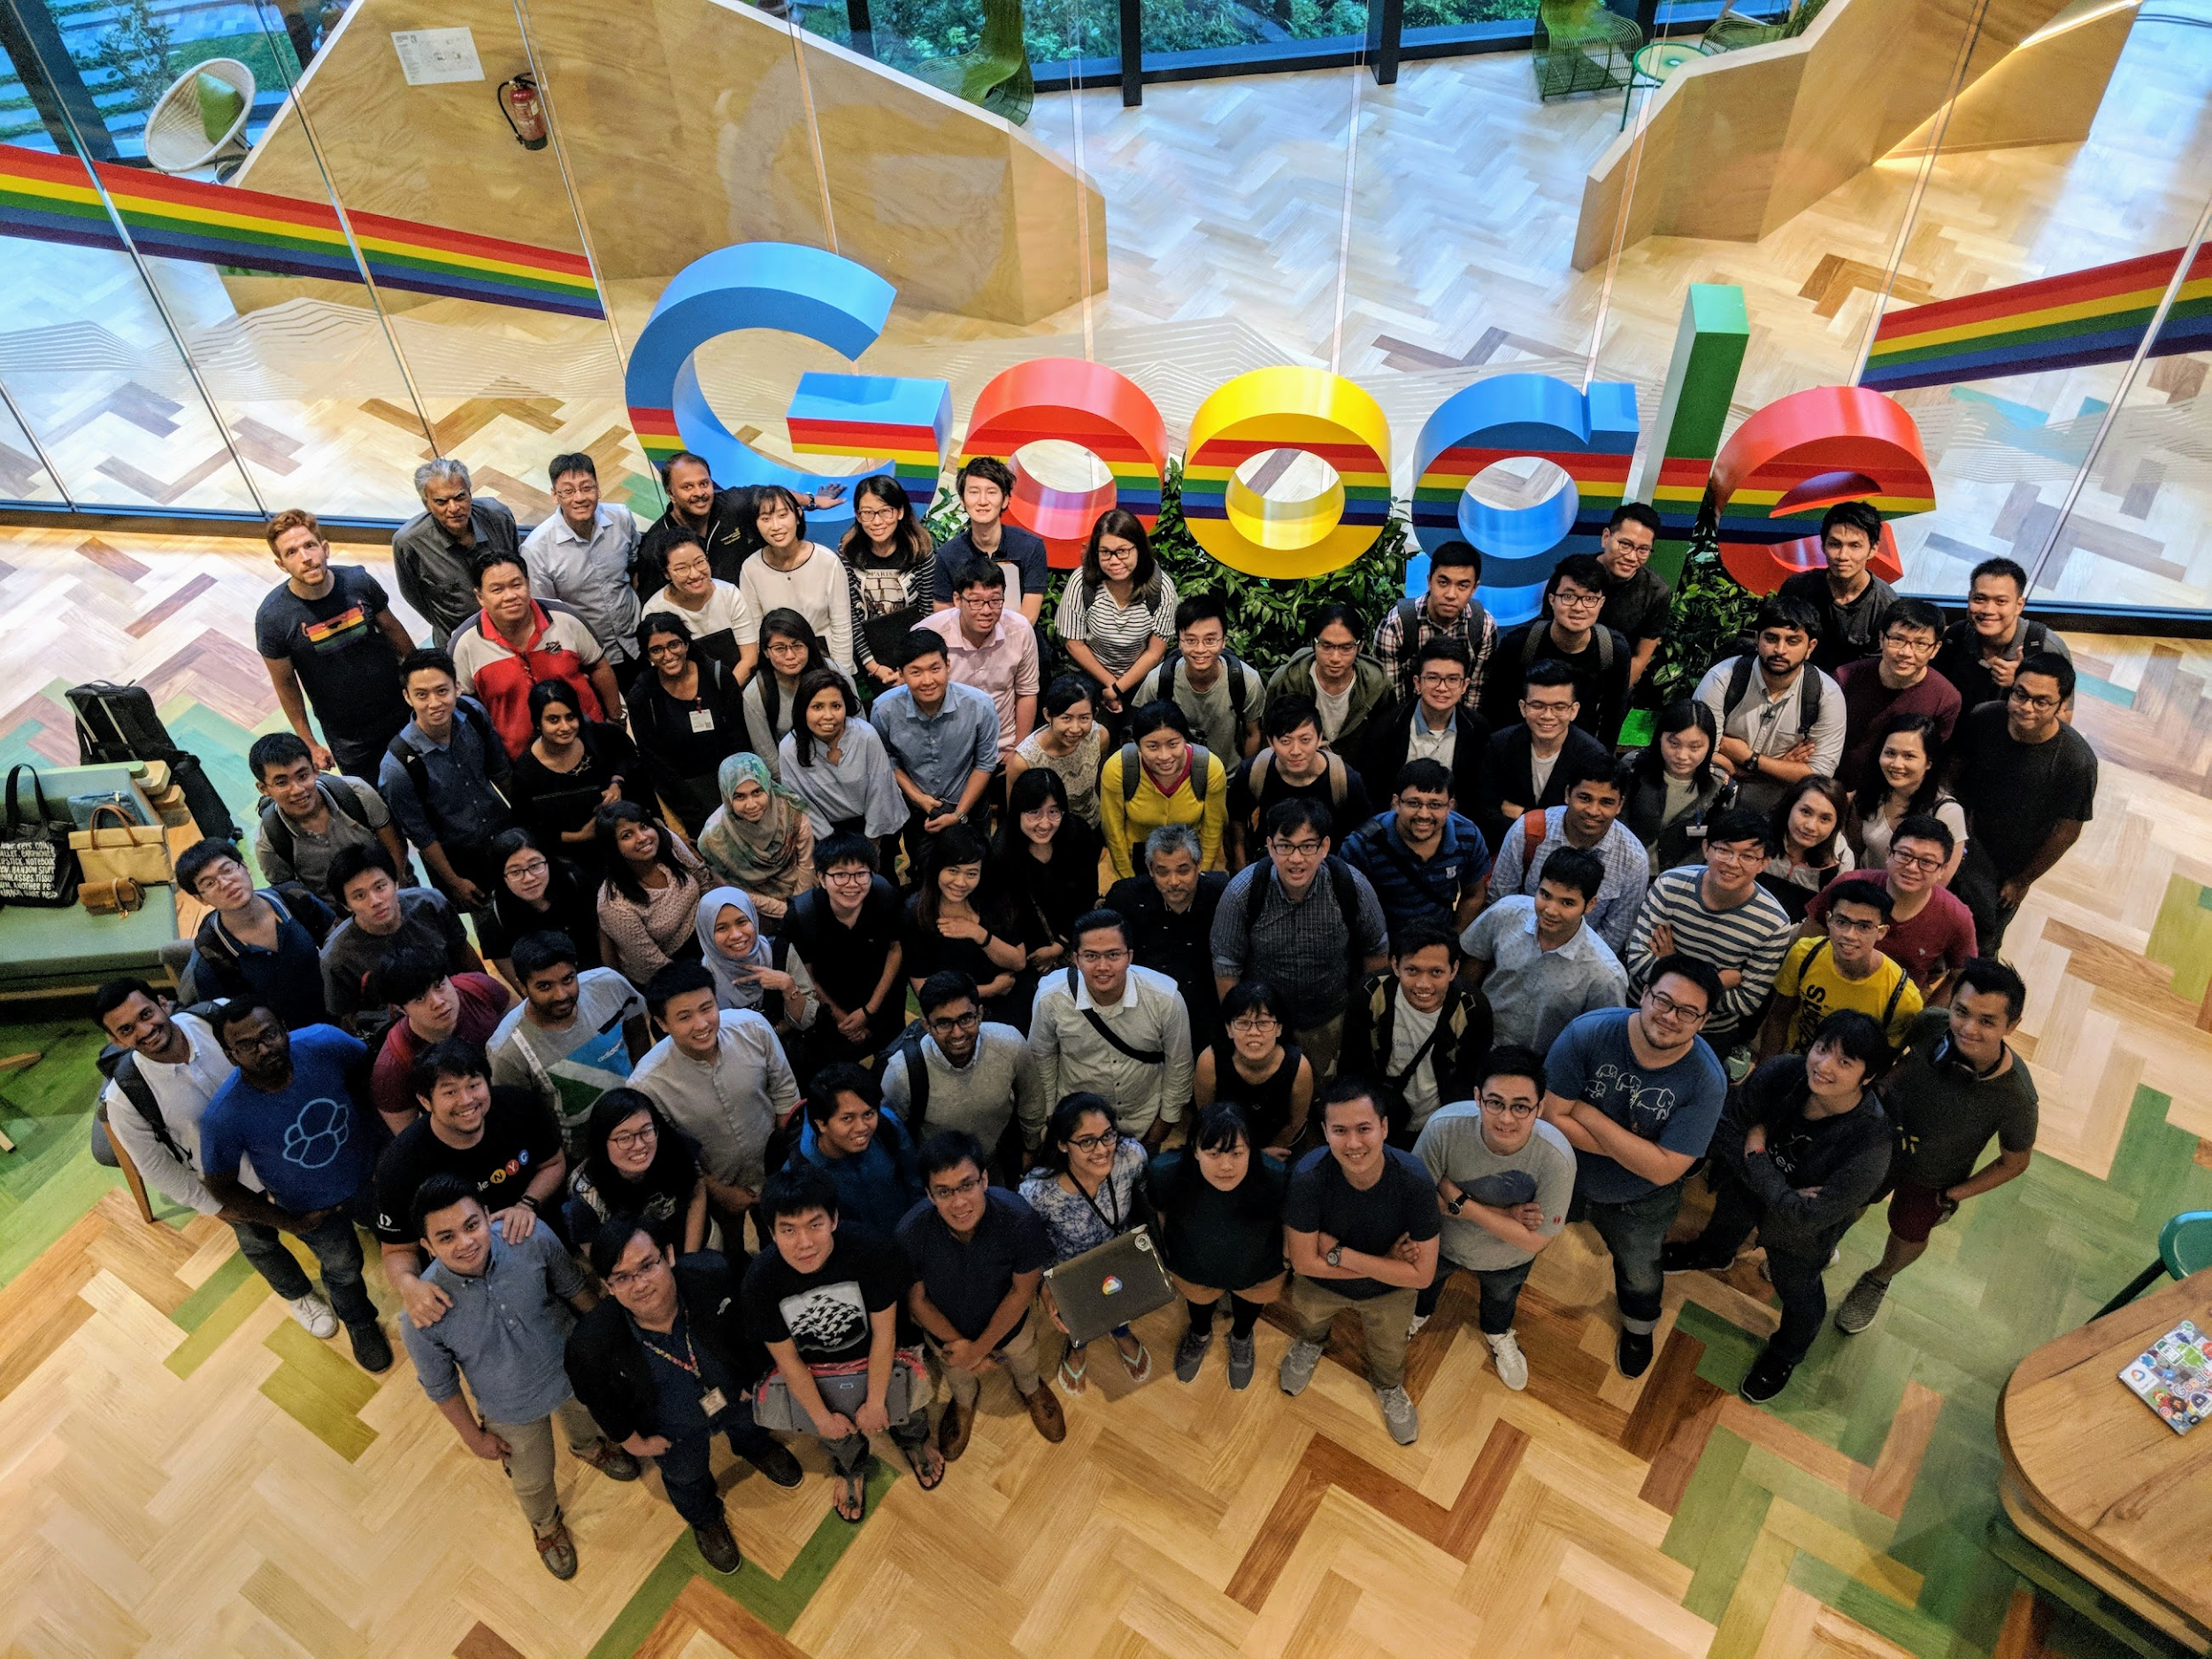
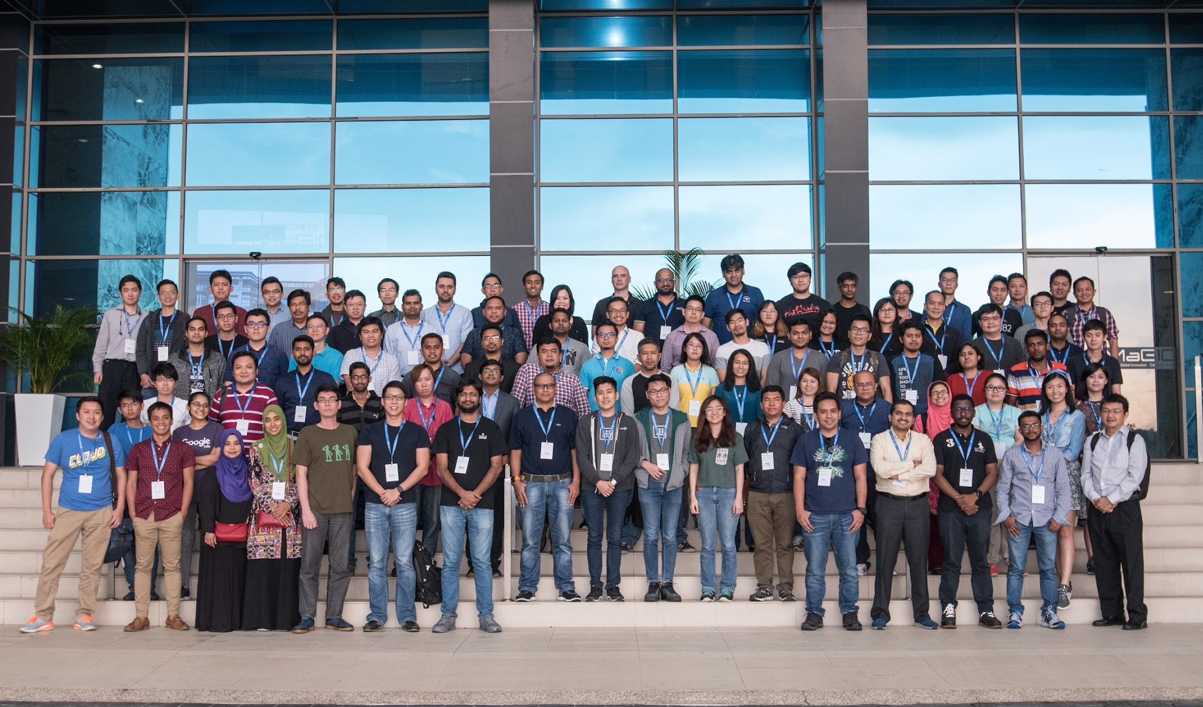
Why run a Machine Learning Bootcamp?
ML bootcamp is a great opportunity to bring the developer community in your region together to learn fundamentals & application of Machine learning using TensorFlow and Google Cloud Platform. This will give a boost to an individual’s ability to implement ML in their company’s existing/future product/s, resulting into more innovation and more growth.

Slide 4
Machine Learning Bootcamp Content
(detailed kit here)
Module-1
Design
Module-2
Learn
Module-3
Study
Module-4
Build
Duration: 4 hours
Aim: To introduce participants with design thinking approach to frame ML problems
Format: Design thinking workshop
Participants receive: Detailed design thinking guide & materials
Duration: 4-6 hours
Aim: To get participants understand ML theory & practice through study groups
Format: Group Study
Participants receive: 1 month free access to relevant course on Coursera
Duration: 4 hours
Aim: To get participants understand Google Cloud Platform ML offerings through codelabs
Format: Hands on labs
Participants receive: 1 month free & unlimited access to Qwiklabs
Duration: 4-6 hours
Aim: To help participants develop a working ML model to solve a real world problem
Format: Hackathon
Participants receive: $XXX GCP credits to build prototypes

Slide 5
Organizing an ML bootcamp

Slide 6
Reference timeline
Module-1
DESIGN
Module-2
LEARN
Module-3
STUDY
Module-4
BUILD
Pre-event (1 month)
Hold the ML Bootcamp (within ~2 months)
Post-event (1 month)
Find a location and Decide your target audience
Organizers should take a Train-The-Trainer session with Google team
Celebrate the completion of 4 modules :)
Opportunities leading towards more rewards & professional certifications.

Slide 7
Partner checklist
Use this checklist to track your readiness for the bootcamp.
Pre-Event | Post-Event
⬜ Find a Venue | ⬜ Run the in-person event (4 modules)
⬜ Submit the organizer registration form | ⬜ Set-up & maintain support channels
⬜ Find trainers | ⬜Recognition - Celebrate graduation!
⬜ Attend the Train-The-Trainer Hangout | ⬜ Submit organizer feedback form
⬜ Create an event page
⬜ Promote your bootcamp
⬜ Send confirmations & pre-event message

Slide 8
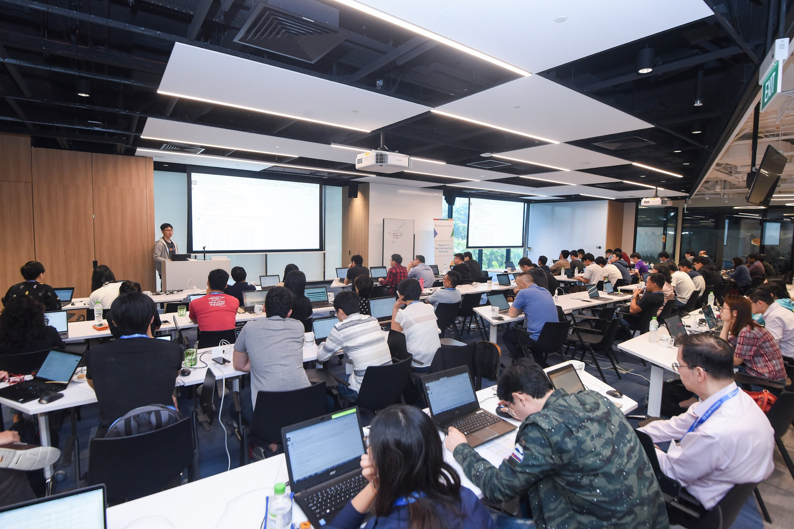
Find Venue
Find a venue which has:
Internet connection, wifi or ethernet. The labs require a connection to run.
Chairs and tables. Attendees will be using their laptops.
Power outlets. The event will run for about 3-5 hours.
A projector that the Facilitator can use to share their screen with attendees.
Idea setups: Training room, Maker lab, Coworking space, Auditorium

Slide 9
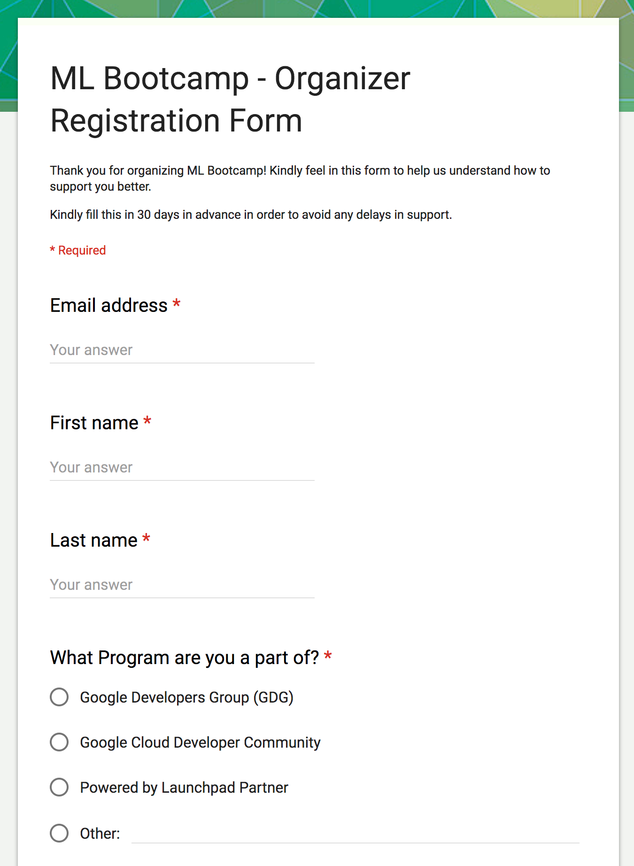
Submit Organizer Registration Form
Register your bootcamp by filling in this form: bit.ly/MLB-register ideally before 30 or more days of hosting the first module.
In the form:
Indicate the dates & schedule for each module + target number of attendees
Indicate speaker requests (subject to availability of speakers)
Indicate if you need any additional support
After filling in the form, watch your inboxes for Invite for the TTT session + Coursera & Qwiklab vouchers
Please email at ml-events-help@google.com if there’s change in your plans with regards to your event.

Slide 10
Find trainers
Design
Study & Learn
Build
1 main facilitator, 3 volunteers
1 main facilitator, 3 volunteers
1 main facilitator, 3 mentors
Facilitator : Someone who has delivered a design sprint/ design thinking workshop in past for a group of 25-30 people. Familiarity with ML use cases (in depth knowledge of ML/AI not required).
Example: GDE/ certified sprint master / UX expert
Volunteers : Someone who is familiar with design thinking methodology and is keen to help teams understand the process. Eg. Community organizers.
Facilitator : Someone who has delivered training/sessions on ML & GCP (knowledge of both theory & application), Experienced with qwiklabs (completed quests), worked on a real life ML project.
Example: Cloud Study Jam (CSJ) facilitator / GDEs / Trainer
Volunteers : Someone who is familiar with qwiklab platform and is keen to help teams with session related doubts/help when stuck. Eg. CSJ attendees who completed quests.
Facilitator : Someone who has participated in any hackathon, has experience building ML models (using TF & GCP), and has fair understanding of end to end ML project lifecycle.
Example: GDE / Organizer of ML/Cloud community
Mentors : Experienced ML practitioners in industry who can mentor teams on building their ML models, familiar with TF & GCP applications.

Slide 11
Attend the Train-The-Trainer session
Train-The-Trainer hangouts will be hosted to give trainers & organizers an overview of ML bootcamp content, curriculum, modules & facilitation.
Upcoming hangouts:
Date 1, time
Date 2, time
If you’ve filled in bootcamp registration form, we will extend an invite to you for this session - you can invite your trainers to join the same. The trainers can choose to attend any one of the two.

Slide 12
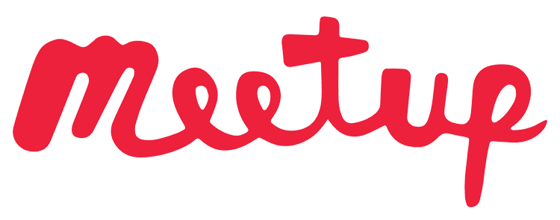
Create an event page
We recommend using Meetup.com
When entering your event details...
The event title must contain the words “ML Bootcamp”.
Make separate events for each separate module. For example, “ML Bootcamp <Design>”, “ML Bootcamp <Study>” etc.
Feel free to write your own event description or copy parts or all of the sample description on the next page.

Slide 13
Example Description*
We’re super excited to bring “Machine Learning Bootcamp” to our [Community Name]. This Bootcamp is a one stop solution to learn about Google’s latest ML offerings. The 4 module intensive bootcamp will include workshop, training, hands on sessions and a project.
What is included:
Design thinking workshop
Walkthrough of ML fundamentals using GCP & TensorFlow
Guided codelabs on GCP ML products like Cloud ML, Auto ML Vision, BigQuery ML
Hands on project experience (guided by ML mentors) to solve real life problems by applying ML in practice
This bootcamp will be suitable for developers:
Who are strong programmers
Who are at least somewhat familiar with Python and Google Cloud Platform
Who know at least a little about linear algebra and calculus.
Who are interested to learn and apply ML in your day-to-day work and projects
This bootcamp is not recommended for:
Participants with extensive machine learning backgrounds.
Participants looking to learn about the lower-level intricacies of raw TensorFlow. Although the course does contain some basic TensorFlow exercises, most of the exercises focus on high-level Tensor APIs.
Participants seeking advanced topics in machine learning such as image convolutional models and recurrent/sequential models.
When? [Insert time & dates]
Where? [Insert place]
Interested candidates fill in this form [Insert form] and register for ML Bootcamp by [Deadline]. Upon confirmation of your seat, you would be notified latest by [Insert date] via email.
* This is a sample description. Feel free to personalize to your community.

Slide 14
Promote your Bootcamp
Social media posts coming soon...

Slide 15
Send confirmations and pre-event message*
Confirmation Email template:
Confirmation for ML Bootcamp
Hi [name],
This email confirms that you have successfully registered for the My Event!
Module-1 Design
Date & time: [Insert details]
Location: [Insert address]
Please bring your own laptop for the working sessions. Also, you can change or cancel your registration from the registration page.
We look forward to seeing you there!
Thanks!
Pre-event Email template
Hi [name],
We’re looking forward to seeing you at ML Bootcamp tomorrow!
Pre-work for the bootcamp:
If you have some extra time, we encourage you to go through the following, to prepare yourselves better for the bootcamp [insert pre-work]
Final checklist for the bootcamp:
You can come to [directions to venue]
Plan to arrive by 9:30am. The session will start sharp at 10am.
We’d need you to bring
Your laptop and charger
Pen & paper (or any other preferable option if you plan to take notes)
A can-do attitude!
For any unavoidable reasons, if you’re not able to make it to the bootcamp, please let us know by replying to this email so that we can open up slots for people in waitlist.
Thanks!
* This is a sample description. Feel free to personalize to your community.

Slide 16
Run the in-person bootcamp (4 modules)
1. Setup
Help attendees set up necessary environments, tools & networks for the respective module.
2. Agenda
Share the detailed agenda of the day and set expectations what would attendees learn at the end of the session.
3. Module
Run in person labs/ workshop/ hackathon as per the module content.
4. Feedback
Gather feedback after the end of each module (verbal or through form)
5. Wrap up
What’s next? Encourage attendees to revise & self study to strengthen their skills (share materials).
Share what attendees will learn in next module.

Slide 17
Set-up & maintain support channels
It is very important to keep the students motivated throughout the bootcamp cycle, especially in between two modules, when they self study a lot of things.
There will be times when they will get stuck and might give up because there’s no one checking in or no one there to help out. Utilise the power of collaboration and community.
Keep in touch with them through different online mediums like email, slack channel, hangout session, whatsapp group etc to see if there are any struggles they’re facing and if you could help them!

Slide 18
Recognition - Celebrate graduation!
We will be shipping you a swag kit - which you can choose to give to participants based on finishing various modules.
Here’s an attendance certificate [insert link] you can print & share with the attendees of your event - who attend all the three modules. Celebrate with your group upon completion of the course!

Slide 19
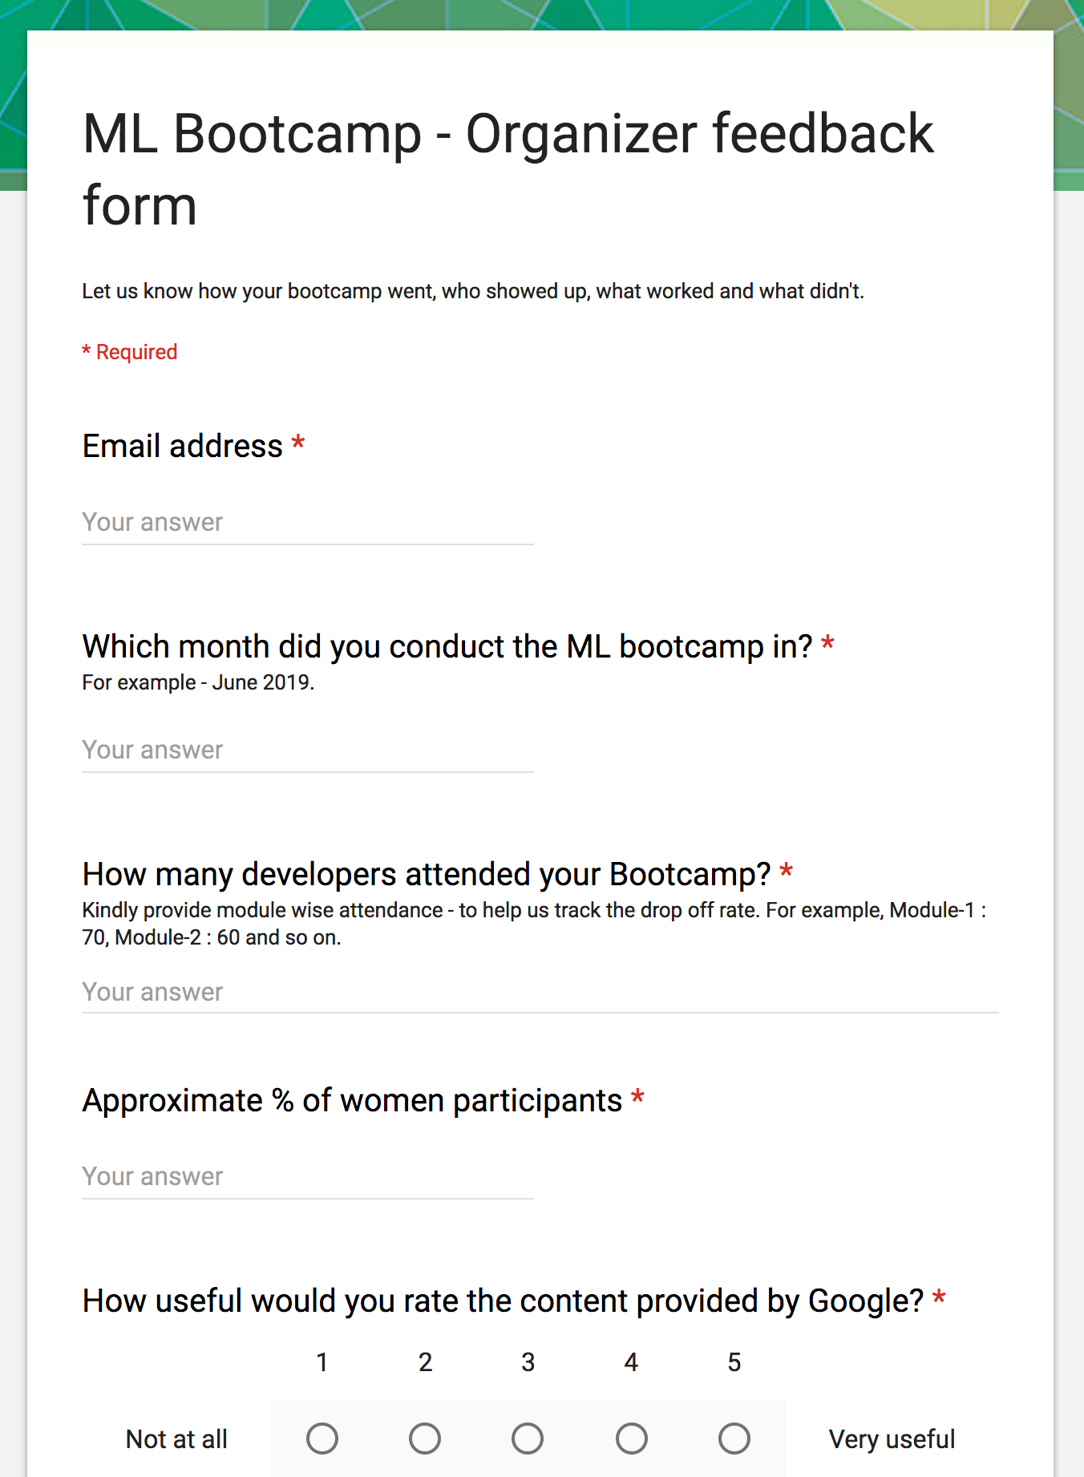
Submit Organizer Feedback Form
Done with the bootcamp? Kindly fill in this form and let us know how it went.
bit.ly/MLB-feedback
You are the expert on what works in your community. We want to hear from you, so future bootcamps will be even more awesome for you and your members!

Slide 20
Digital Assets
To be added
Guidelines
Logo
Poster
Banner
Certificate
Holder
Stickers

Slide 21
Questions? Write to us!
Email: ml-events-help@google.com
PoC: desaiv@google.com or thyeyeowbok@google.com

Slide 22
Thank you

